Slide 1
Assignment 4 - HashTable

Slide 2
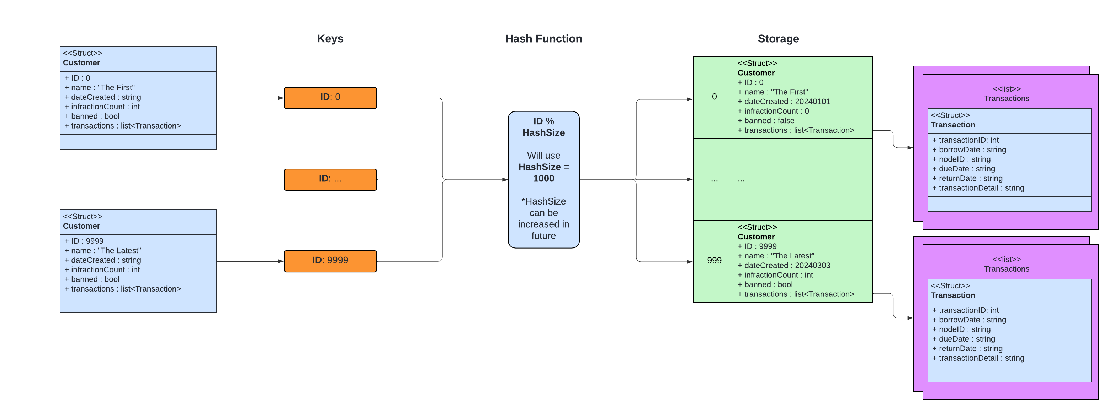
HashTable Diagram
Notes:
1.) Hashtable maps customer data to ID 2.) Within customer data is a pointer to the list of transactions for that customer. 3.) push_front to insert latest transactions at front 4.) pop transaction to remove 5.) iterator to traverse list to find transaction ID as needed, or fully traverse to print out complete list of transactions

